Slide 1
Chicken Vision
Walkthrough
Peter Chacko, Team 3997 Screaming Chickens

Slide 2
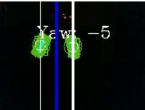
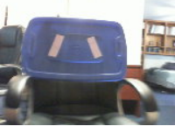
How do I get from a camera to target tracking?

Slide 3
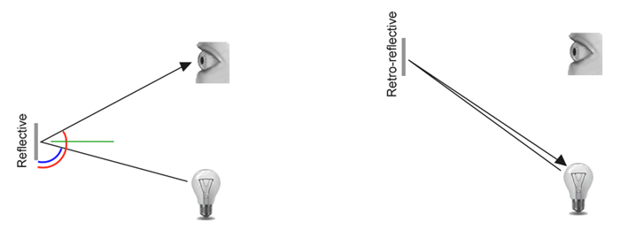
Know your targets!
The targets are retroreflective tape. Instead of light reflecting like off a mirror, light bounces directly back at the light source.

Slide 4
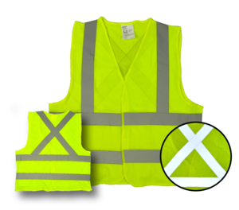
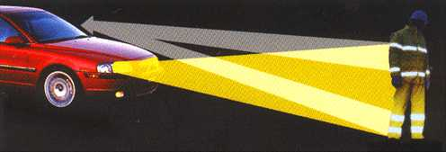
Other retroreflective materials

Slide 5
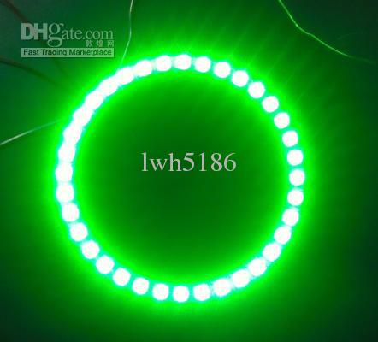
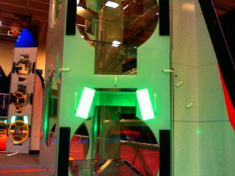
2. LED Ring. This lights up the target, so it can be easily identified.

Slide 6
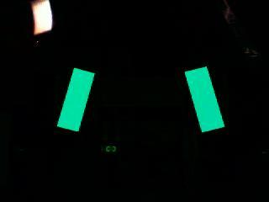
3. Lower exposure, so only the brightest lights (the targets + little noise) are visible
Most of the image is black, so now only the targets and a few bright lights are visible to the camera!

Slide 7
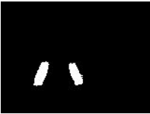
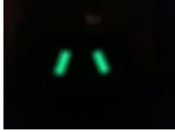
Color filter (HSV)
We need to filter this image so only the targets are recognized. In order to do this, we employ a HSV (or color) threshold to highlight only the green targets. This turns the pixels white where green is found, but black everywhere else.
The image is smoothed to reduce noise

Slide 8
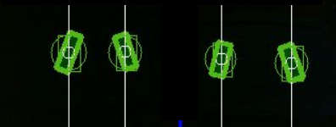
Find Groups of Pixels (Contours)
The computer vision library (OpenCV), finds groups of white pixels and calculates their coordinates, area, angle, etc...
The computer recognized each of these as contours and drew rectangles around them

Slide 9
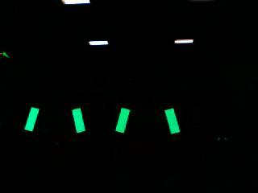
Distinguishing between targets.
Since there are multiple strips of retroreflective tape, determining which ones to identify as targets is a challenge.
Target
Target

Slide 10
Look a little deeper
Targets are adjacent (next to each other) and form a peak. False targets form a “V”
Peak
Peak
V

Slide 11
How Chicken Vision addresses this.
Select two contours at a time (sorted from left to right):
Contours are adjacent
Left contour is tilted right
Right contour is tilted left
If all these statements are true, then we found a target

Slide 12
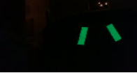
We determined our targets. Now what?
Goal: Find the degrees needed to align with the target:
Calculate Horizontal Angle (Yaw) of the center of the target from the camera

Slide 13
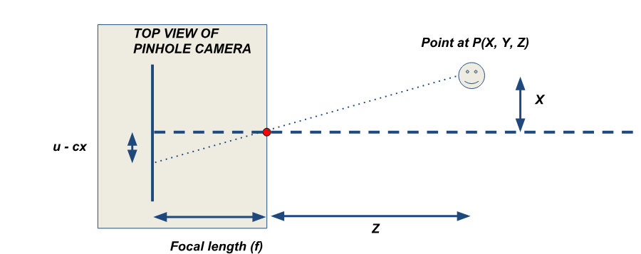
Using what we know + some properties of the camera, we can calculate yaw!
Using the horizontal focal length of the camera (which can be calculated with the horizontal field of view), we can use trigonometry to calculate yaw.
Credit: Team 254

Slide 14
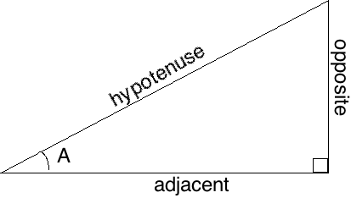
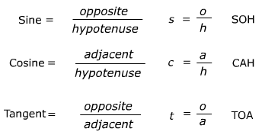
Math Class! Similar Triangles + Tangents
B = A
If we find B, then we found A
If we know opposite and adjacent, we can find angle using arctangent!
We know dis
B
We know dat

Slide 15
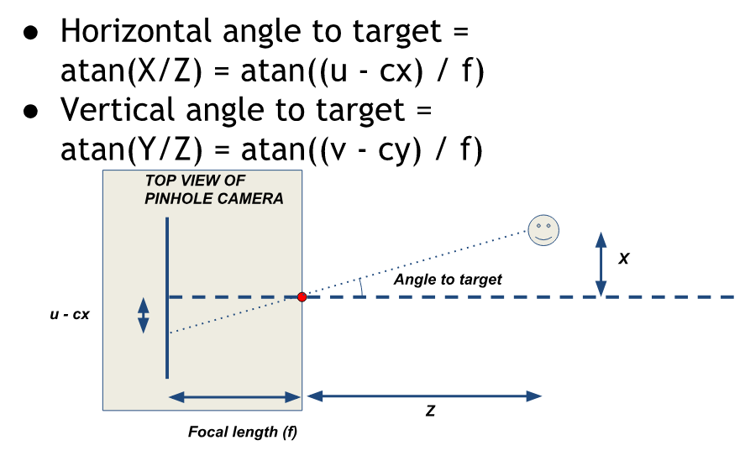
Applying Math!
Credit Team 254

Slide 16
Booom! You did it!
You started from a raw image and now are tracking objects! With great power comes great responsibility :)

Slide 17
Resources
Team 254 Vision Presentation: https://www.team254.com/documents/vision-control/
WPILib Vision Resources:https://wpilib.screenstepslive.com/s/currentCS/m/vision/l/288983-target-info-and-retroreflection
#ChickenVision: https://github.com/team3997/ChickenVision
images from Google image, WPILib, 254

